Slide 1
Combo Creator
By George Heimsath

Slide 2
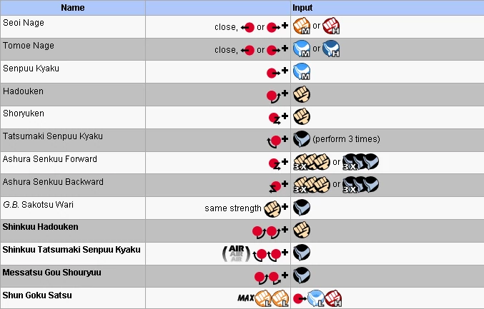

Slide 3
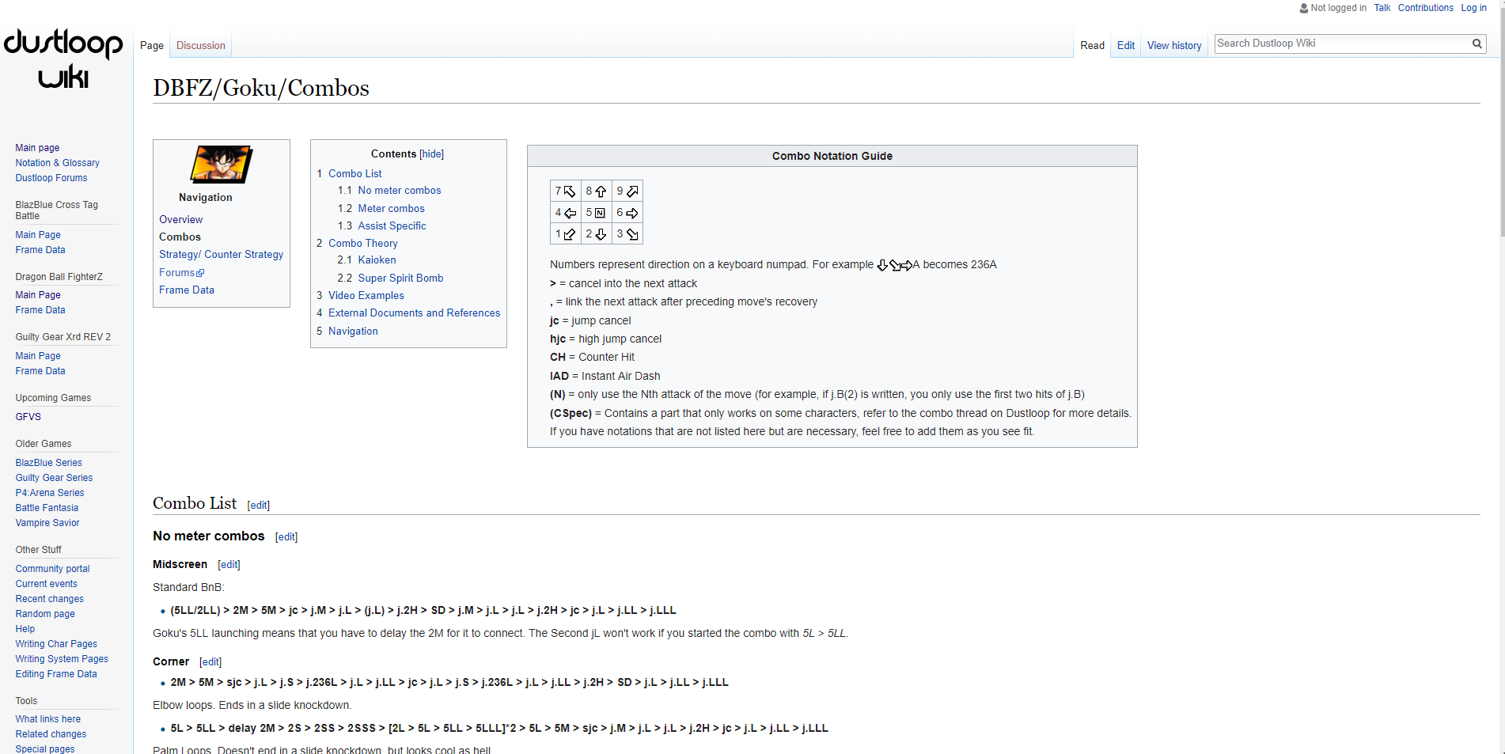
The Problem Continued

Slide 4
My Solution / Tech Demo
http://34.76.91.33:8080/

Slide 5
Tools used
Springboot
Git + Github
Model Branch feature
MySQL
H2
React
Bootstrap
Trello

Slide 6
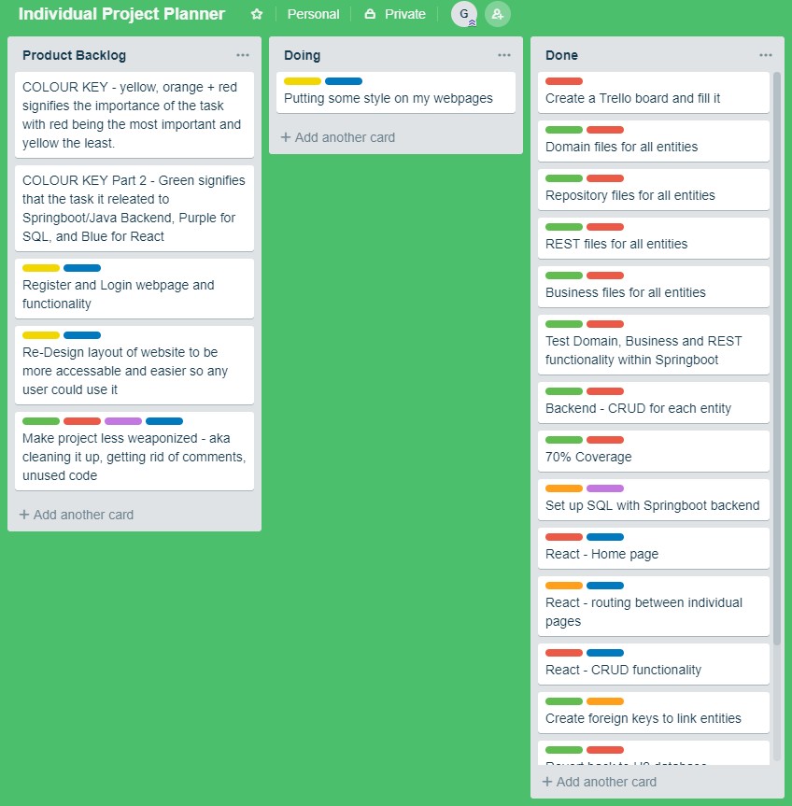
Trello

Slide 7
The Good and the Bad
Good:
+ Springboot
+ Bootstrap
Bad:
- React
- Planning and Tracking

Slide 8
Conclusion
What I would have done better now knowing what I know:
Layout of Task
Better understanding of the layout of my own project
As well as the task
Productivity:
Upload to git more frequently
Update trello board more frequently

Slide 9
Any Questions?

